Slide 1
Market Volatility Pattern Analysis
Amazon Intraday(5-min interval) Stock of last 1 week(17-12-2024 to 23-12-2024)
Presented by: Tafseer Kousar

Slide 2
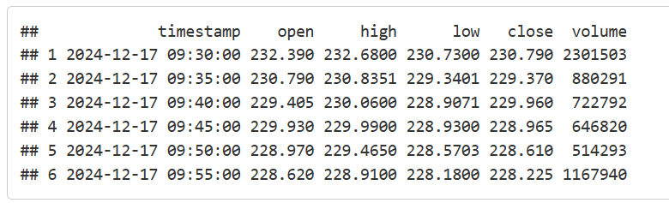
Data Overview

Slide 3
Data Preprocessing
Missing Values: Removed rows with missing values to ensure data integrity.
Return Calculation: Computed log returns of closing prices to analyze price changes.
Outlier Removal: Method: Detected and removed extreme values using the Interquartile Range (IQR) method. Formula:
IQR = Q3 - Q1
Outlier Range = [Q1 - 1.5 × IQR, Q3 + 1.5 × IQR
Process: Values outside this range were treated as outliers and removed to maintain data consistency.
Final Dataset: Ensured a clean, ready-to-use dataset by removing all invalid entries.

Slide 4
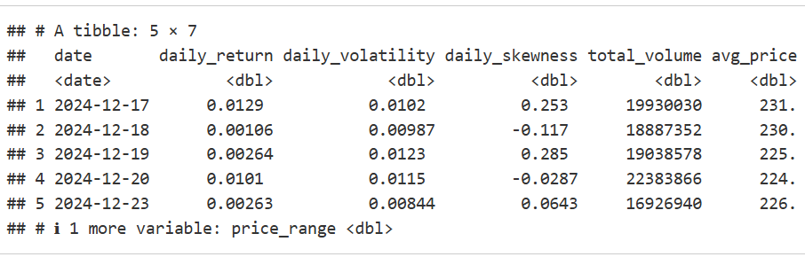
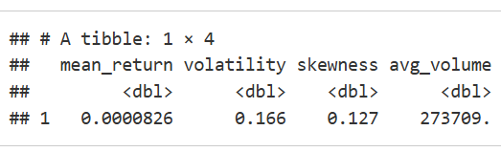
Statistical measures
Daily Metrics:
Summary Statistics:

Slide 5
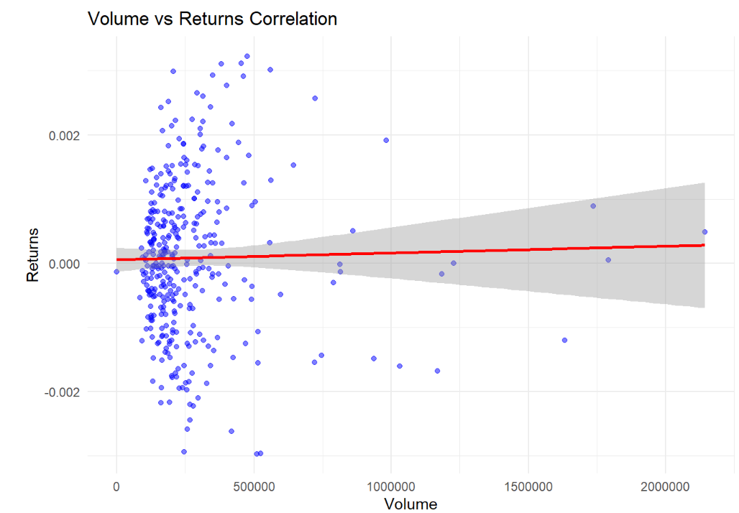
Volume-Returns Relationship Analysis
This graph shows Amazon's 5-minute trading patterns over the past week, comparing trading volume (how many shares were traded) with returns (price changes).
Key Observation: The scattered blue dots and nearly flat red line reveal that higher trading volumes don't strongly influence stock returns – a vital insight for trading strategies.
Pattern Analysis: Most trading happens in the lower volume range (left side), with returns typically staying between -0.2% to +0.2%, showing stable price behavior during normal trading.
Risk Insight: The widening gray area at higher volumes suggests that large-volume trades come with more unpredictable price movements – crucial for risk management.
Business Impact: This data challenges the common assumption that high trading volumes predict significant price changes, helping stakeholders make more informed decisions.

Slide 6
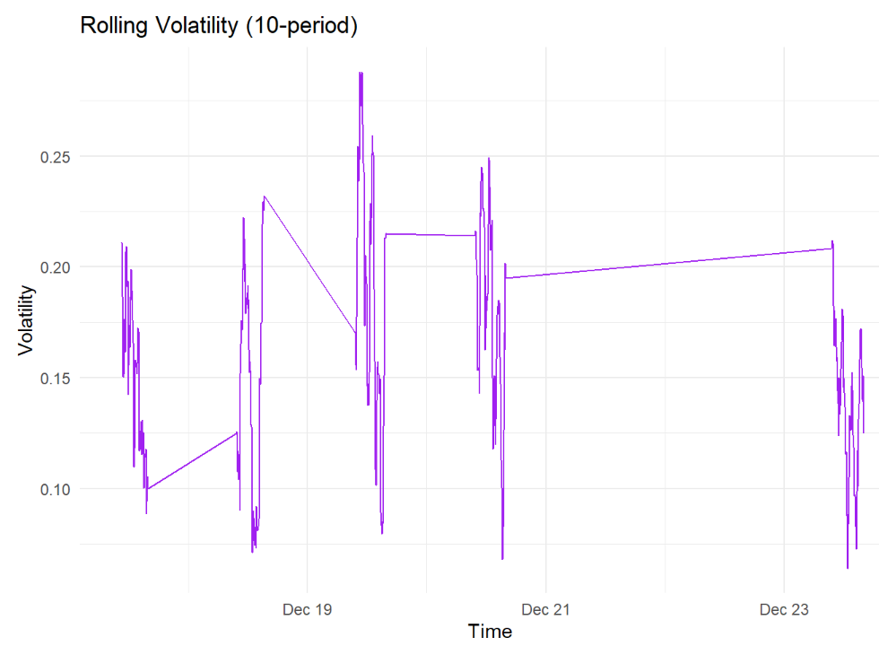
Rolling Volatility Analysis
This graph tracks Amazon's stock price stability over 10 trading periods, showing how much the price fluctuates (volatility) from December 17-23.
Key Pattern: The purple line's peaks and valleys reveal periods of high uncertainty (peaks) and relative calm (valleys) in Amazon's stock price movements.
Market Insight: Major volatility spikes occurred on Dec 19 and Dec 21, reaching nearly 0.25 - indicating moments when the market was most uncertain about Amazon's value.
Stability Analysis: Between volatile periods, the stock shows periods of calmness (lower points in the graph), suggesting regular cycles of market stability and uncertainty.
Trading Impact: This volatility pattern helps stakeholders identify high-risk trading periods (peaks) versus more stable trading windows (valleys), crucial for timing investment decisions.

Slide 7
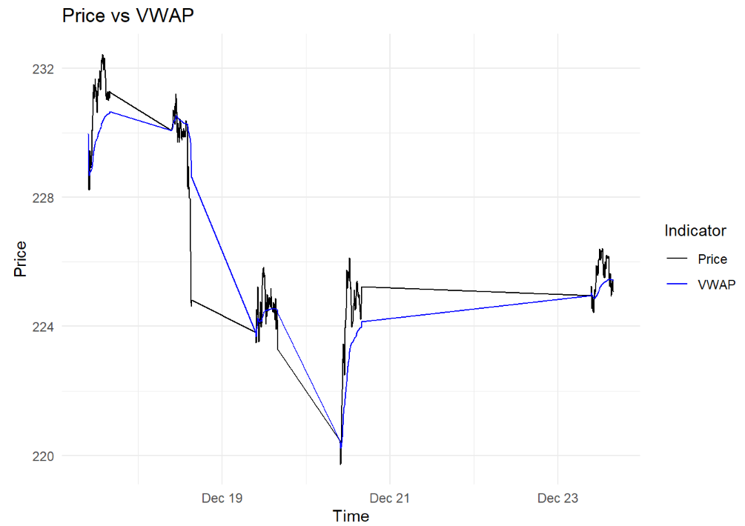
Volume-weighted average price
This graph compares Amazon's actual stock price (black line) with its Volume-Weighted Average Price or VWAP (blue line) from December 17-23, showing how the current price compares to the average trading price.
Key Pattern: When the black line (price) crosses above the blue line (VWAP), it suggests the stock might be overbought; when it crosses below, it might be oversold – providing critical timing signals for trades.
Notable Movement: A significant price drop occurred around Dec 21, falling to $220, but the stock showed resilience by quickly recovering and stabilizing.
Trading Insight: The VWAP (blue line) acts like a moving support/resistance level, helping identify whether the current price is relatively high or low compared to the day's average trading price.
Investment Impact: This comparison helps stakeholders identify potential entry and exit points, especially when price and VWAP lines converge or diverge significantly.

Slide 8
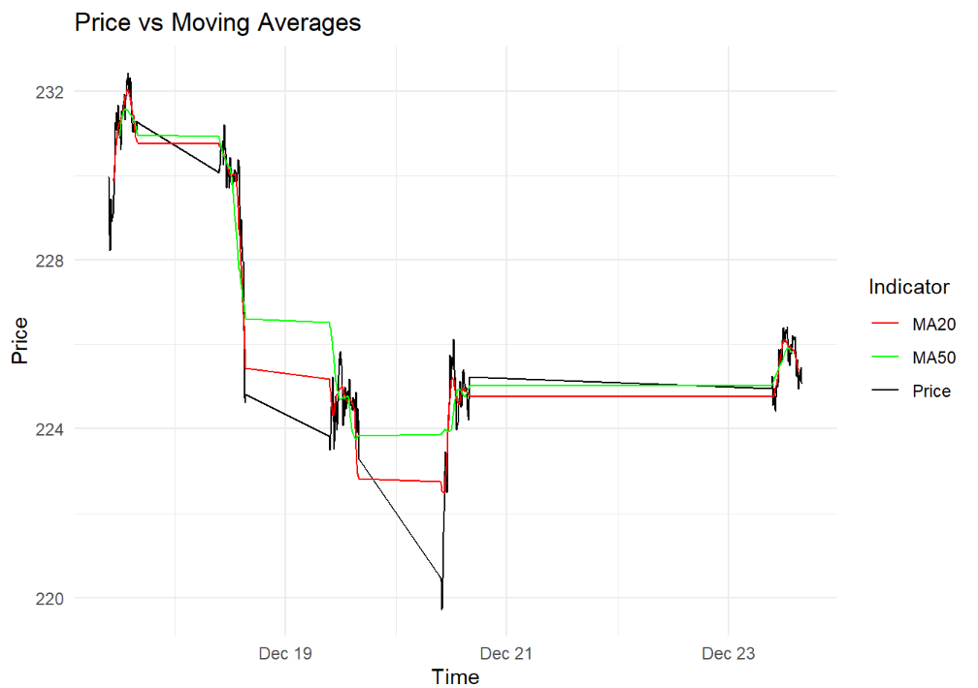
Price vs Moving Average
The graph displays Amazon's stock price (black line) compared against two key trend indicators: the 20-period moving average (MA20, red line) and 50-period moving average (MA50, green line).
Key Insight: These moving averages act like trend "smoothers" - MA20 responds more quickly to price changes, while MA50 shows longer-term trends, helping identify the overall market direction.
Critical Points: When the price line crosses above both moving averages (like on Dec 21), it signals potential upward momentum; crossovers below suggest possible downward trends.
Market Behavior: Notice how the price experienced sharp volatility around Dec 21 (dropping to $220) but quickly recovered above both moving averages, indicating strong buyer support.
Trading Strategy Value: The relationship between these three lines helps stakeholders identify trend strength and potential reversal points - crucial for timing investment decisions.

Slide 9
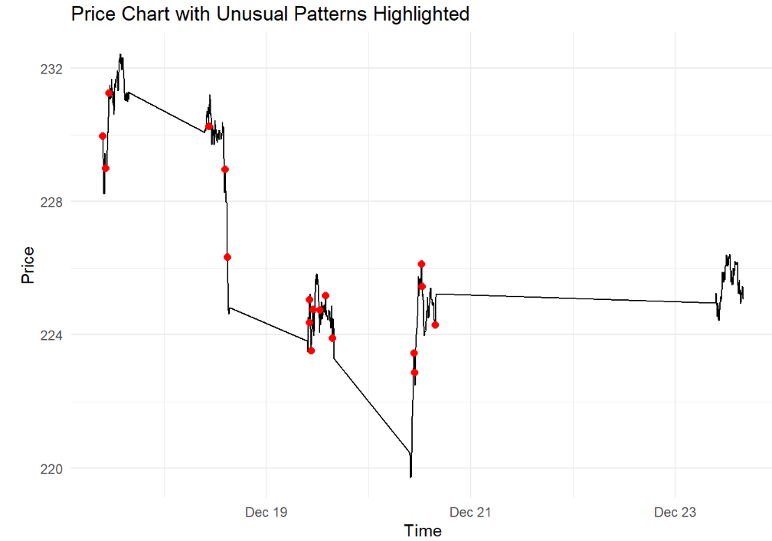
Identify Unusual Pattern
The graph marks unusual price movements (red dots) in Amazon's stock over a full trading week (December 17-23), offering a comprehensive view of market anomalies.
Key Pattern Detection: The highest concentration of unusual patterns (red dots) appears between Dec 19-21, suggesting this was the most volatile period of the week.
Market Narrative: The stock shows a clear downward trajectory from Dec 19 ($232) to Dec 21 ($220), followed by a strong recovery and stabilization around $225 by Dec 23.
Risk Indicators: Red dots cluster during sharp price movements, particularly during the mid-week decline, highlighting periods of elevated market stress and uncertainty.
Strategic Value: These unusual pattern indicators help stakeholders identify periods of market dislocation and potential trading opportunities across the full weekly cycle.

Slide 10
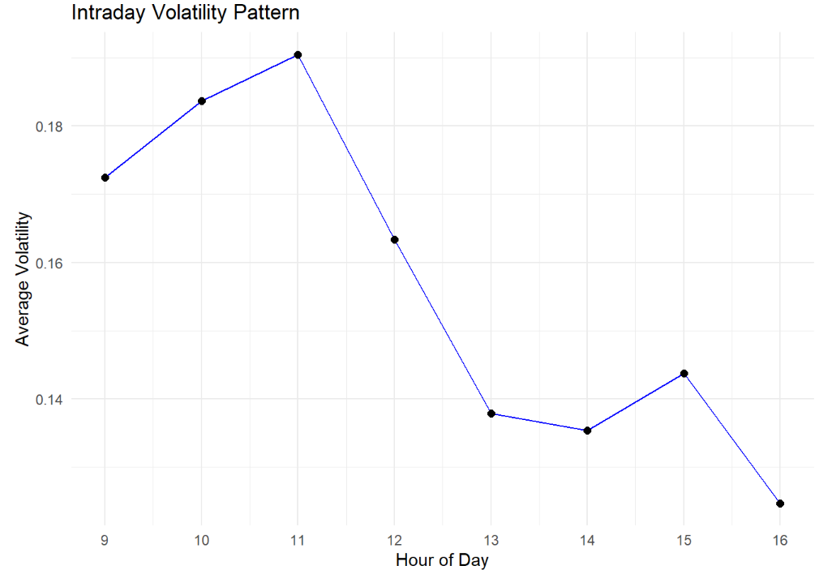
Interesting Pattern Investigation: Intraday Volatility
This graph reveals Amazon's average stock volatility across different hours of the trading day (9 AM to 4 PM), showing when price movements are typically most and least volatile.
Market Opening Pattern: Volatility steadily increases from market open (9 AM) to peak at 11 AM, indicating heightened trading activity during morning hours.
Peak Activity: The highest volatility occurs at 11 AM, suggesting this is typically the most active and potentially risky trading hour.
Afternoon Calm: A sharp decline in volatility after 11 AM, with consistently lower levels throughout the afternoon, points to more stable trading conditions.
Trading Strategy Value: This pattern helps stakeholders optimize their trading timing - morning hours require more careful risk management, while afternoon trading might offer more predictable conditions.

